Slide 1
And
All you ever wanted to know about…..

Slide 2
The bits we are looking at…

Slide 3
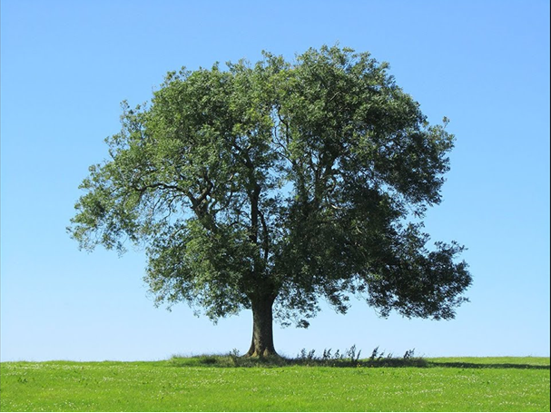
Stays – What wood do we use?
Fraxinus excelsior

Slide 4
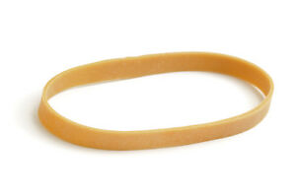
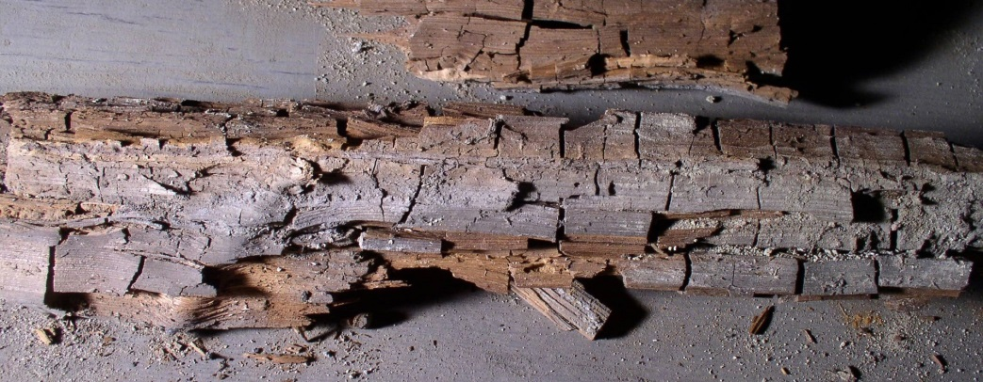
What do we want from a Stay?
Strength
Elasticity
Anti Rot

Slide 5
Stays – Why use Ash?

Slide 6
Stays – Why use Ash?
Straight grain gives strength
This also gives elasticity
Hard woods less likely to rot
If grain not straight, lines
Can form weak spots where
Cracks can occur
Weak points

Slide 7
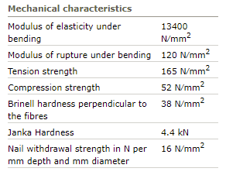
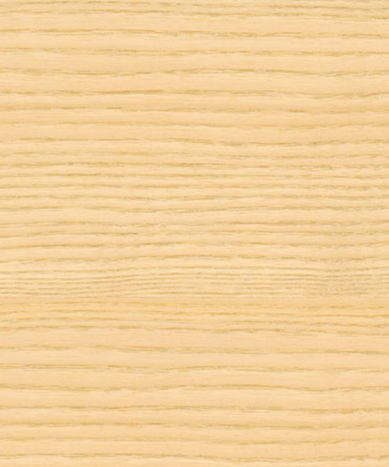
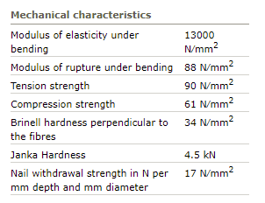
Stays – Why use Ash?
The science bit……..
Ash
Oak
Grain is straight and even

Slide 8
General suggestions
Always a couple of spare roughly sized stays available
If you have one stay that breaks a lot (a training bell perhaps) keep a spare ready to go!
If you can get a set of measurements for you stays, do so, it makes life easier

Slide 9
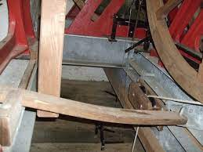
Stay Types
Plain Stay:
By far the most common type
Fairly straightforward to fit
Been used forever
Found on both metal and wooden headstocks
A plain stay resting up against slider
with the bell in the “up” position

Slide 10
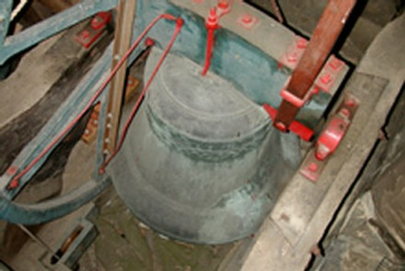
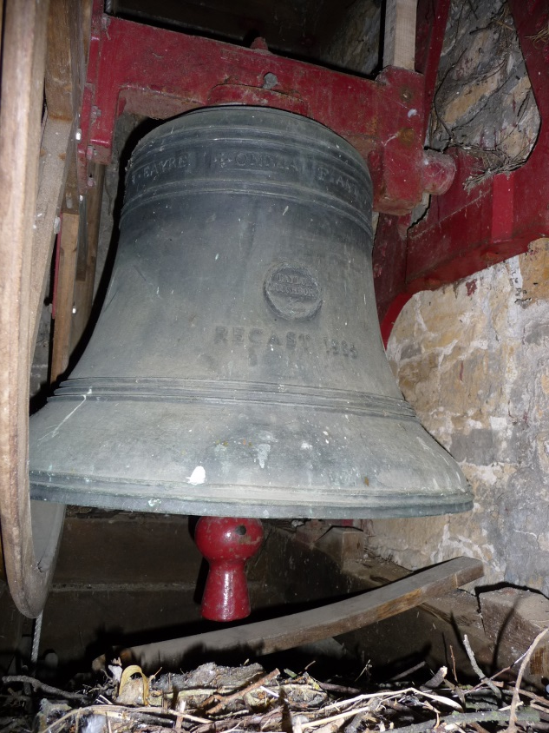
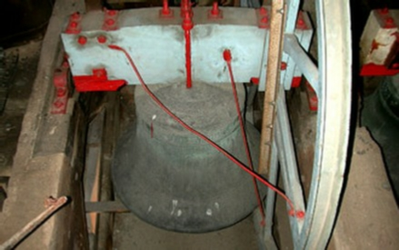
Plain Stays
A plain stay on a wooden headstock,
held on by 3 bolts and a metal strap
A plain stay on a metal headstock,
just held in place with two bolts

Slide 11
Stay Types
Hastings Stay
Used mostly during the first half of 20th century
Invented by the Rev. J. F. Hastings, M. A, who was one time vicar of Martley, in Worcestershire.
Only found on “Modern” metal Taylor headtocks
More difficult to fix than plain stays, as they need shaping

Slide 12
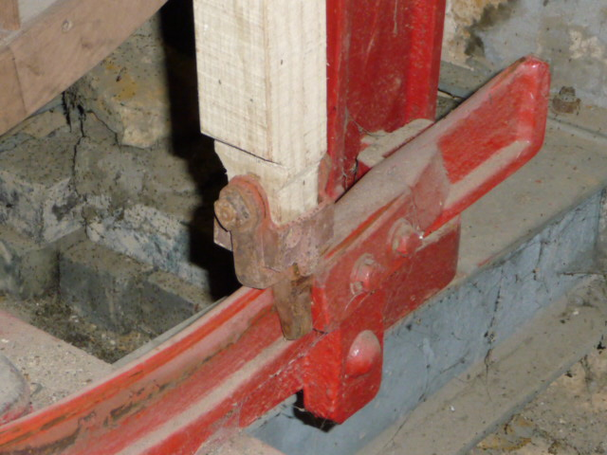
Hastings Stays
Hasting Stay up against end stop
More difficult to fit, what’s the point?
What advantage do Hasting stays offer, and for who?
Drawing of Hasting stay mechanism

Slide 13
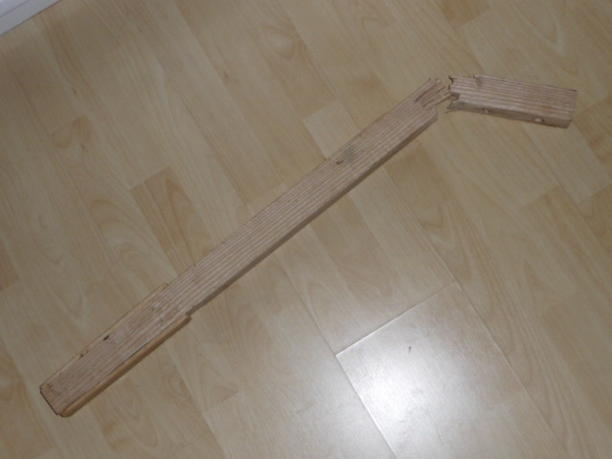
My stay is broken, Can I mend it?
Fixing Broken Stays
Many people have tried it!
Some with better results than others
Will never be as strong as a new stay
Can be useful to act as a temporary spare
Any suggestions on how they can be joined together?

Slide 14
Replacing stays – Both types
Remove old stay and join parts back together to get length
Tools needed:
Saw
Plane (an electric one if possible)
Tape Measure
Drill and drill bits
Adjustable Spanner
Time!

Slide 15
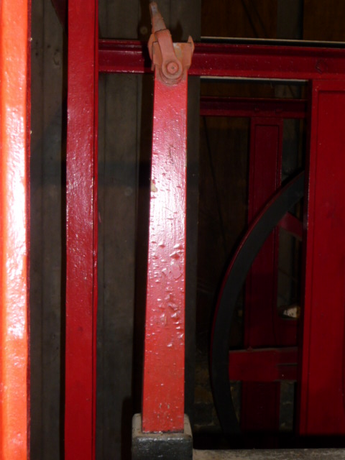
Replacing a broken Hastings Stay
Hasting Stays are tapered
The “official” way as given in
Taylor’s notice

Slide 16
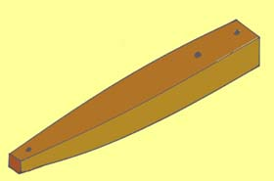
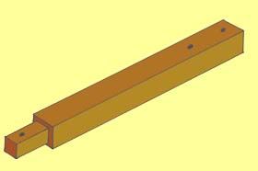
Replacing a Broken Hasting Stay
A Different Approach
The Whiting Society website gives details on how
To make a square top section Hastings stay.
This is easier to shape than the traditional tapered design
This can make like a little easier.
See:
https://www.whitingsociety.org.uk/articles/stay-making/hastings-stay.html

Slide 17
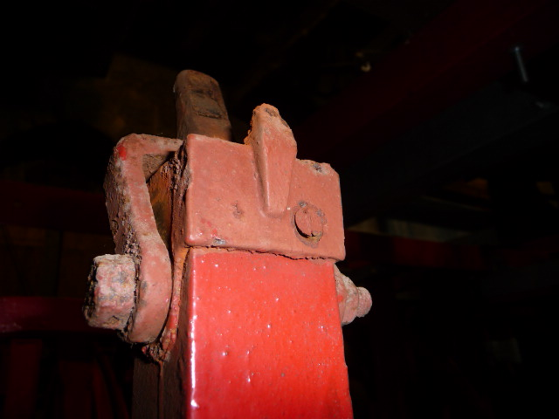
Replacing a broken Hastings stay
Hasting Stays must be the correct length
What do you think the problems would be if they are not?
Too long
- Binding
- Bell won’t stand
Too short
Bell won’t stand
Bell will go over the balance!

Slide 18
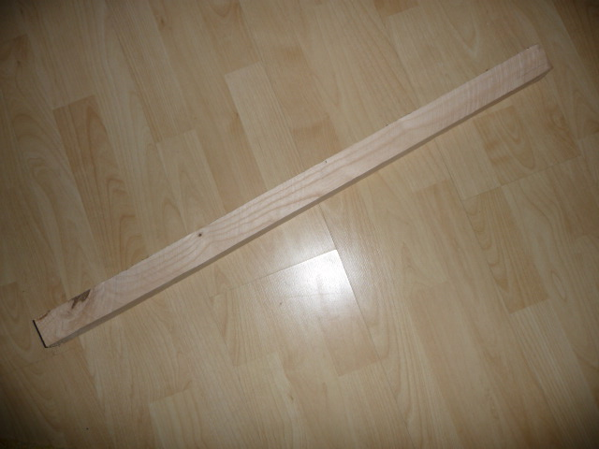
Replacing a Plain Stay
Easy! (Compared to a Hastings Stay)
Cut to length
Plane to size
Drill holes
Fit
Length not so crucial as Hasting, but there are limits. What could be the problems?

Slide 19
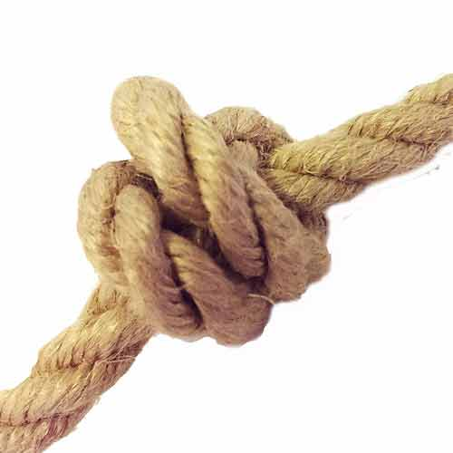
Ropes
Two main types of ropes used:
Natural Fibre
There are two natural fibres that are used for making bell ropes:
Flax is the most common type used. Flax can tend to absorb moisture and change length – shorter in winter and longer in summer
Hemp is a little harder wearing than flax, but can be more expensive than flax. Suffers from the same problem, but to a lesser extent
All natural fibres can rot with time. Especially in damp environments

Slide 20
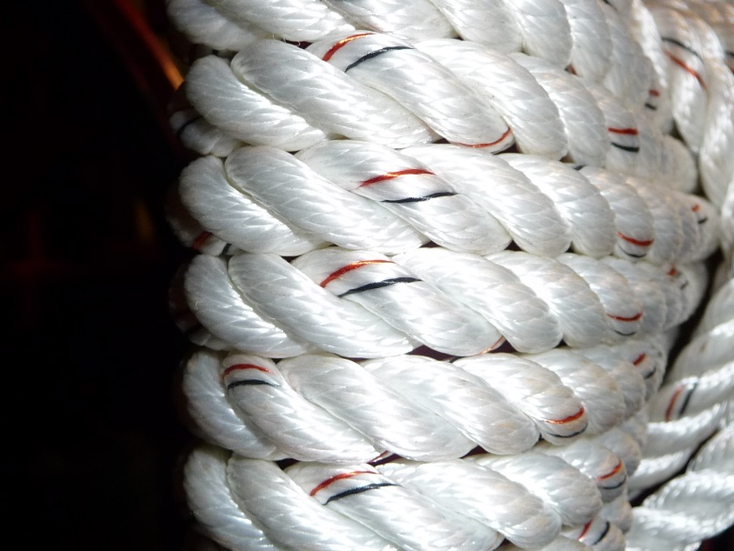
Ropes
Manmade Fibre
Pre-stretched Polyester – Sometimes called Terylene offers a very hard wearing rope that will not absorb water, stretch or rot.
Only used on top ends.
Can cost more than pure Flax or Hemp, but much harder wearing
Orange/Black bands indicate this is military grade, which most rope suppliers use.

Slide 21
Ropes
Sally
Made of wool
Tends to compress over time and become flat

Slide 22
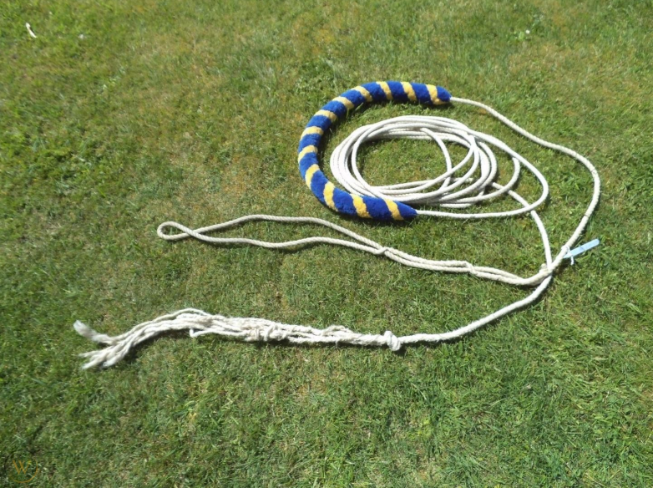
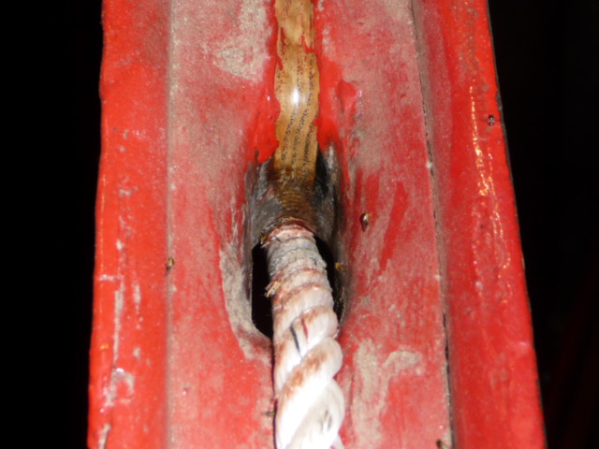
Checking a Rope
Checking a Rope
If it is worn, then it’s usually quite obvious!
Check trail end for worn or damaged strands
If tail end hit the floor check these areas carefully
Run hand up the Sally looking for loss of wool, which my indicate a broken strand
Check the garter hole area picture (top) shows what can happen!
Bottom picture shows a Terylene rope, with no wear at all

Slide 23
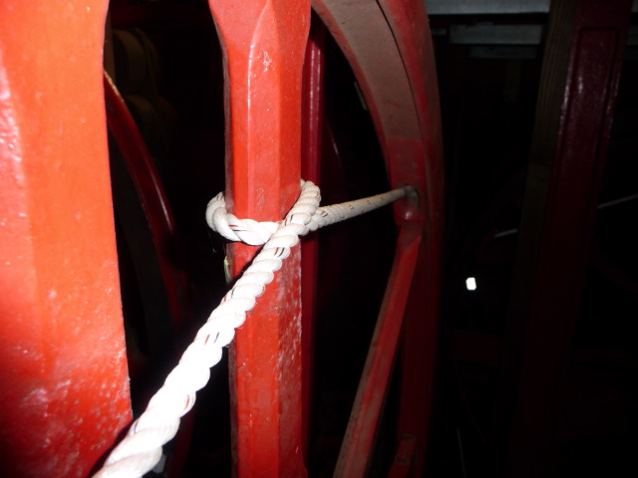
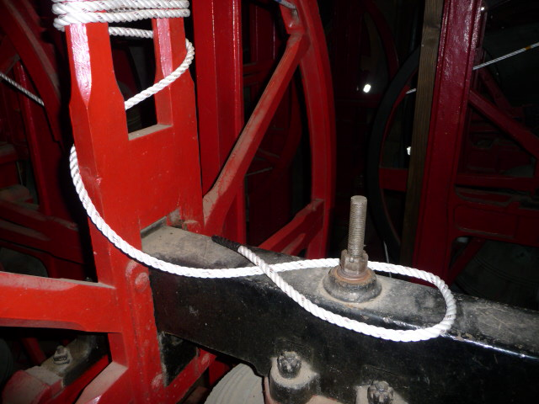
Changing a Rope
Changing a Rope
Assuming the old rope is complete, best to tie the new rope the tail end of the old one and pull it up!
Pass the new top end through the garter hole and start to pull the rope up
You will need a helper to get the sally height right
Once you have the right height, rap the rope around the spoke once
Then rap the rope round and round the two spokes until about 3 feet is left

Slide 24
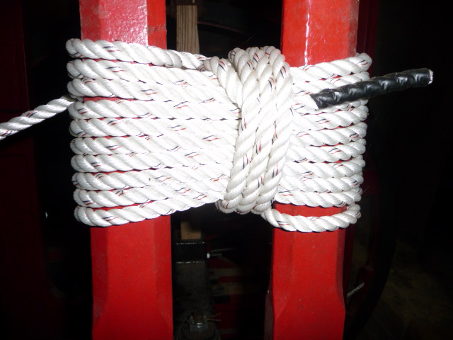
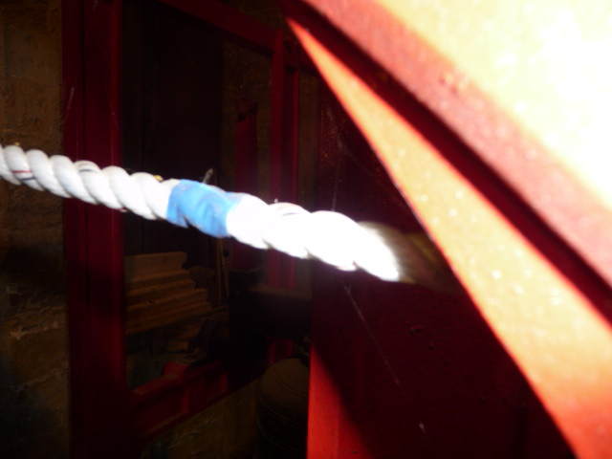
Changing a Rope
Changing a Rope
Rap the remaining rope around the loops already made
When you reach the end, tuck it in securely
Once done, It is a good idea to mark just inside the garter hole with some tape.
Therefore if you ever have to take the rope off again, you know exactly how much is needed in the wheel to give the correct Sally height

Slide 25
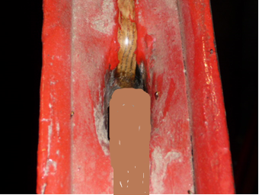
Garter Sleeves
Garter Sleeves
A leather sleeve that fits over the rope in the garter hole
Acts as a strain relief, which is supposed to make the rope last longer.
Can be of some benefit on natural ropes, but not much effect on man made rope
Not so common these days
Could not find a real garter sleeve,
So tried to draw one (Badly)

Slide 26
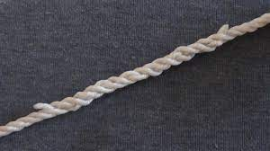
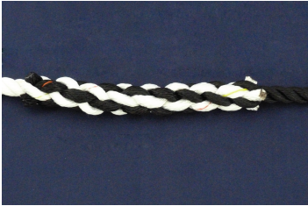
Help - My rope has broken!
Joining it all back together
Long Splice
Best suited where a rope will pass through or over, such as passing through a ceiling boss or through a pulley block
May be a little more difficult that a short splice
Short Splice
Suited where the rope will not pass through things, but could still be used is spare rope is limited
The choice for splicing on new tail ends
Lots of videos on YouTube showing how to do it, if you would like a go!

Slide 27
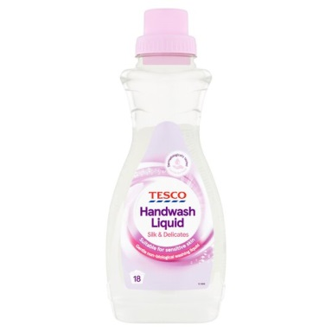
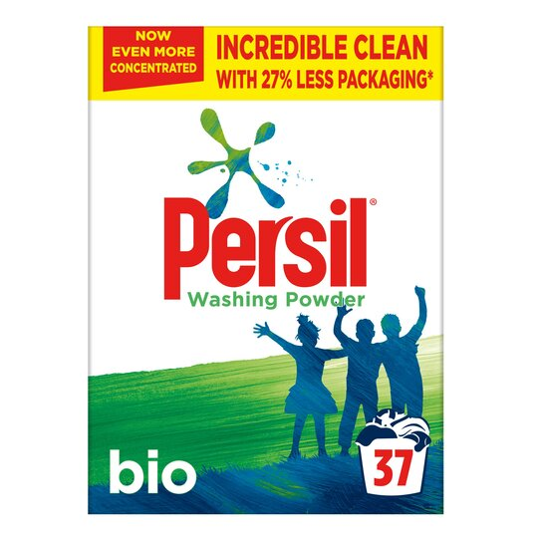
Looking After your Ropes
Looking After Ropes
Being made of natural fibre, ropes are subject to rot and mildew if the conditions are right. This also makes cleaning ropes difficult as chemicals can damage it
Keep ropes dry if possible. If bells are not to be rung for some time, then remove the ropes and store the in dry conditions (Mark the garter holes first!)
If you have mold/mildew, dry the rope out then use a brush and vacuum cleaner to remove the as much as possible. This may be sufficient.
If you have to wash the rope, use cold water and a little mild hand wash detergent. Do not use biological washing powered as the enzymes will break down the fibres and the rope will break easily

Slide 28
Looking After your Ropes
Looking After Ropes
The cleaned rope should be left to dry naturally out of direct sunlight
You can put the rope in a pillow case and spin dry it to help speed up the drying process.
In these current times, it may be tempting to clean ropes with alchol type hand gel.
As rope is a natural fibre this will cause the rope to rot over time
Use it on your hands, not the rope!
Infor from a couple of sailing sites

Slide 29
Any Questions?

